Slide 1
YouTube video statistics
CAPSTONE PROJECT
Presented By:
Ajairamanathan T - 2021309003

Slide 2
OUTLINE
Problem Statement
Proposed System/Solution
System Development Approach
Algorithm & Deployment
Result
Conclusion
Future Scope
References

Slide 3
Problem Statement
YouTube video statistics can vary greatly depending on factors like content, timing, audience engagement, and promotion. However, certain trends often emerge among popular videos:
View Count: High view counts indicate a video's popularity, but they don't necessarily correlate with quality. Viral videos can accumulate millions of views quickly, but engagement metrics provide deeper insights.
Engagement Metrics: Metrics like likes, dislikes, comments, and shares demonstrate audience interaction. A video with a high number of likes relative to views suggests strong viewer satisfaction, while comments and shares indicate audience engagement and community-building.
Watch Time: YouTube's algorithm prioritizes videos that keep viewers on the platform longer. Longer watch times and higher average view durations signal content that captures and retains audience attention.
Trending Status: YouTube's trending page highlights videos gaining rapid popularity across the platform. Trending videos often reflect current events, cultural moments, or viral content.
Subscriber Growth: Successful videos can drive subscriber growth for a channel. Monitoring subscriber counts before and after video uploads can indicate the effectiveness of content in attracting and retaining viewers.
Demographics: Analyzing viewer demographics such as age, gender, and geographic location provides insights into a video's audience and potential reach.

Slide 4
Proposed Solution
To provide YouTube video statistics, you can develop a data analytics platform or tool that collects and analyzes relevant metrics. Here's a proposed solution outline:
Data Collection: Develop a system to collect data from YouTube's API. This API provides access to various metrics such as view count, likes, dislikes, comments, watch time, and demographic information.
Storage: Set up a database to store the collected data. Choose a database system that can handle large volumes of data efficiently, such as MySQL, PostgreSQL, or MongoDB.
Data Processing: Implement data processing algorithms to clean, aggregate, and analyze the collected data. This may involve calculating engagement rates, average watch time, click-through rates, and other relevant statistics.
Visualization: Create dashboards and visualizations to present the analyzed data in an easy-to-understand format. Use charts, graphs, and tables to visualize trends, patterns, and correlations in the data.
Trending Analysis: Implement algorithms to identify trending videos based on criteria such as rapid increase in views, engagement, and social media shares. You can also incorporate natural language processing (NLP) techniques to analyze video titles, descriptions, and comments for trending topics and keywords.
Audience Insights: Provide insights into the demographics and interests of the audience for each video. This can help creators understand their target audience better and tailor their content accordingly.

Slide 5
System Approach
Developing a system for YouTube video statistics involves several components working together to collect, process, analyze, and present data effectively. Here's a system approach for implementing such a solution:
Data Collection Module:
Use YouTube Data API to fetch relevant data about videos, including metrics like views, likes, dislikes, comments, and more.
Implement scheduled data retrieval processes to continuously update the database with the latest video statistics.
Handle authentication with YouTube API to ensure authorized access.
Data Storage:
Choose a suitable database system (e.g., SQL or NoSQL) to store collected data efficiently.
Design a schema that can accommodate various types of data, including video metadata, user interactions, and demographic information.
Data Processing and Analysis:
Develop algorithms to process raw data and derive meaningful insights.
Calculate metrics such as engagement rates, watch time, click-through rates, and audience demographics.
Apply machine learning or statistical techniques for trend analysis, anomaly detection, and predictive modeling.

Slide 6
Algorithm & Deployment
Here's a step-by-step outline for developing an algorithm and deploying a system for YouTube video statistics:
Algorithm Development:
a. Data Collection: - Use YouTube Data API to fetch video metadata and statistics (e.g., views, likes, dislikes, comments). - Implement pagination to retrieve large datasets efficiently. - Handle authentication and authorization with OAuth tokens.
b. Data Processing: - Clean the retrieved data by handling missing values, duplicates, and outliers. - Calculate additional metrics like engagement rate, watch time, and click-through rate. - Aggregate data at various levels (e.g., daily, weekly) for trend analysis.
c. Trending Detection: - Develop algorithms to identify trending videos based on metrics like view velocity, engagement rate, and social media mentions. - Use machine learning or statistical methods to predict future trends and identify anomalies.
d. Audience Insights: - Analyze demographic information (if available) to understand the audience's age, gender, location, and interests. - Use clustering algorithms to segment the audience into distinct groups based on their behavior and preferences.
Deployment:
a. Infrastructure Setup: - Choose a cloud provider (e.g., AWS, Google Cloud Platform, Microsoft Azure) for hosting the application. - Set up virtual machines or containers for running the application and database servers. - Configure networking, security, and access control policies.
b. Database Configuration: - Select a database system (e.g., MySQL, PostgreSQL, MongoDB) for storing video statistics. - Set up database tables, indexes, and partitions for efficient data storage and retrieval. - Configure backups and disaster recovery mechanisms to prevent data loss.

Slide 7
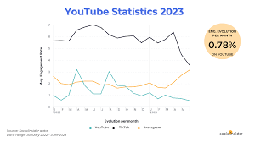
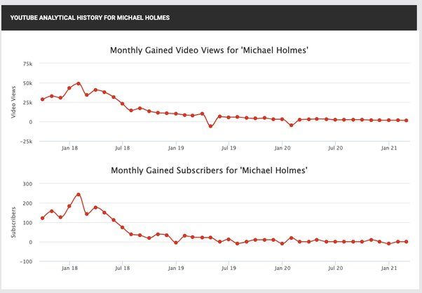
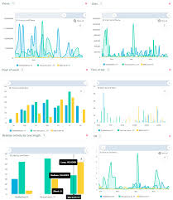
Result
v

Slide 8
Conclusion
In conclusion, YouTube video statistics provide invaluable insights into the performance, engagement, and audience interaction with video content on the platform. Through comprehensive data collection, analysis, and visualization, creators, marketers, and other stakeholders can make informed decisions to optimize their content strategy, increase audience engagement, and maximize the impact of their videos.
Key takeaways from YouTube video statistics include:
Engagement Metrics: Metrics such as likes, dislikes, comments, and shares provide indicators of audience interaction and satisfaction with video content. High engagement rates indicate strong viewer engagement and appreciation for the content.
Viewership Trends: Analyzing trends in view counts, watch time, and subscriber growth helps identify popular topics, formats, and channels. Understanding viewership trends enables creators to tailor their content to audience preferences and maximize reach.
Audience Insights: Demographic information such as age, gender, location, and interests offer valuable insights into the composition and preferences of the audience. Creators can use audience insights to create targeted content and cultivate a loyal fan base.

Slide 9
Future scope
The future scope for YouTube video statistics encompasses several exciting developments and advancements that can further enhance the understanding and utilization of video content on the platform. Here are some potential future directions:
Advanced Analytics: Continued advancements in data analytics and machine learning can lead to more sophisticated algorithms for analyzing video performance, audience behavior, and content trends. Predictive analytics and AI-driven insights can provide creators with actionable recommendations for optimizing their content strategy.
Real-Time Monitoring: Real-time monitoring and analysis of video metrics can enable creators to respond quickly to emerging trends, audience feedback, and performance fluctuations. This can help creators capitalize on viral moments and adapt their content strategy in real-time to maximize engagement.
Personalized Recommendations: Utilizing user data and machine learning algorithms, YouTube can further personalize video recommendations based on individual preferences, viewing history, and behavior patterns. This can enhance user satisfaction and increase the likelihood of discovering relevant and engaging content.

Slide 10
THANK YOU

